Slide 1
Clustering
Xiaochun MAI
Shenzhen University

Slide 2
What is clustering?
Given a set of data points, each described by a set of attributes, find clusters such that:
Intra-cluster similarity is
maximized
Inter-cluster similarity is
minimized
Requires the definition of a similarity measure
F1
x
x
x
x
x
x
x
x
xx
x
x
x
x
x
x
xx
x
F2
Notes:
We need to combine all the

Slide 3
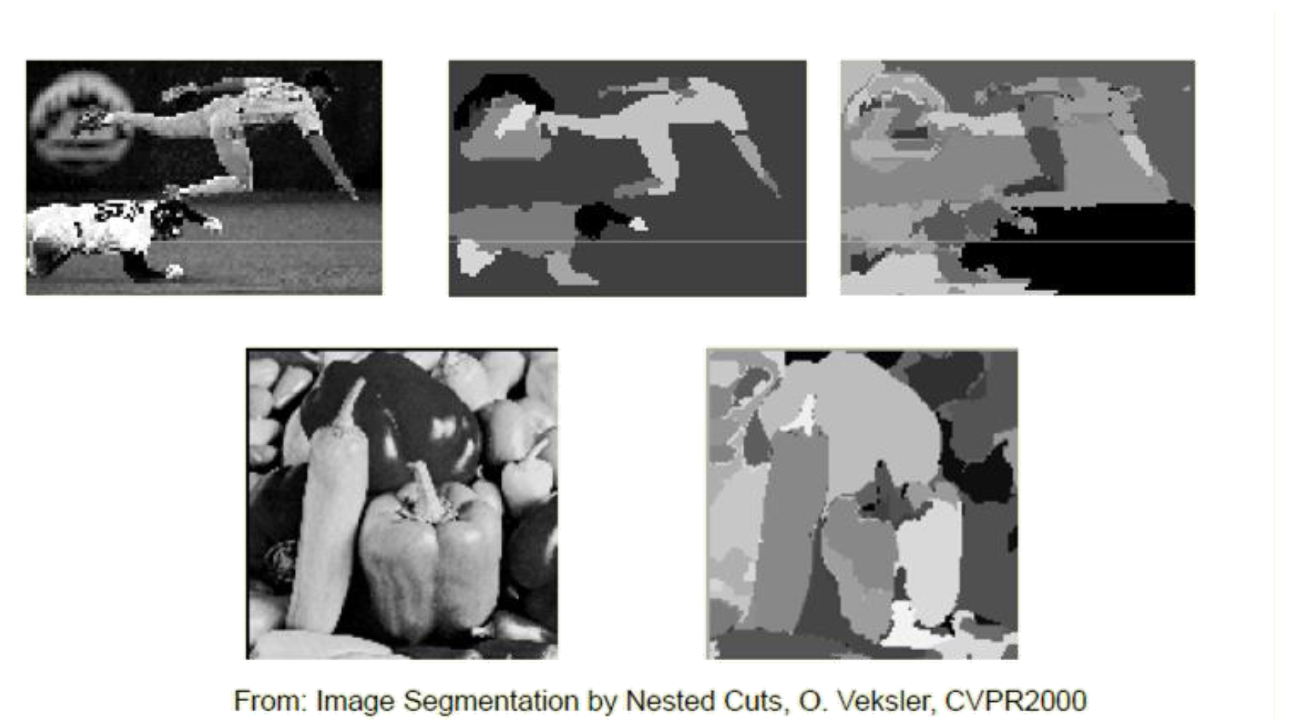
Computer vision application: Image segmentation
Notes:
We need to combine all the

Slide 4
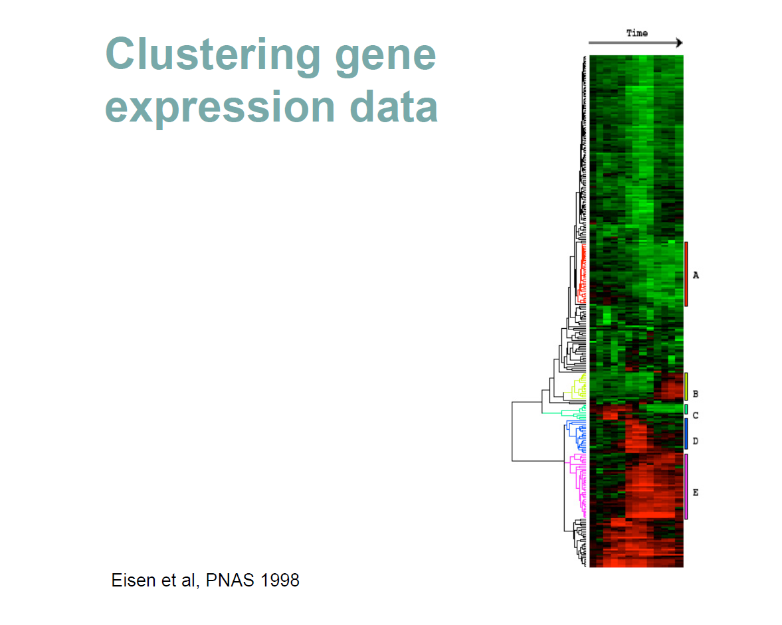
Biomedical application
Clustering gene expression data
Microarrays measure the activities of all genes in different conditions
Clustering genes can help determine new functions for unknown genes
Notes:
We need to combine all the

Slide 5
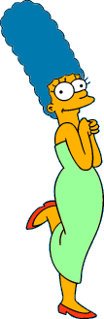











Clustering
Clustering is subjective
Simpson's Family
School Employees
Females
Males
Notes:
We need to combine all the

Slide 6
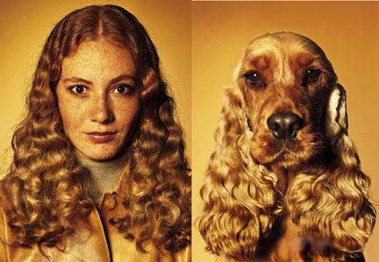
What is Similarity?
Similarity is hard to define, but…
“We know it when we see it”
Notes:
We need to combine all the

Slide 7
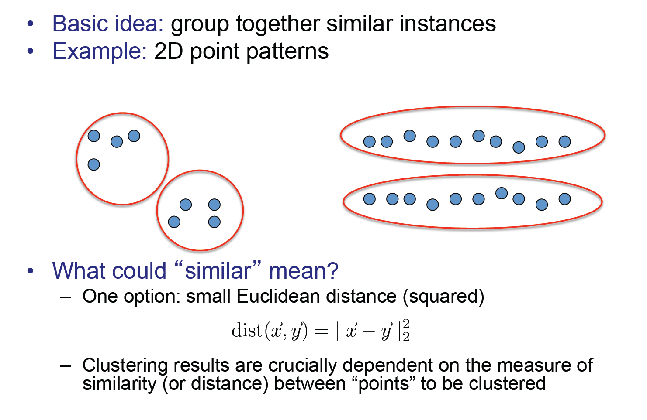
Clustering
Notes:
We need to combine all the

Slide 8
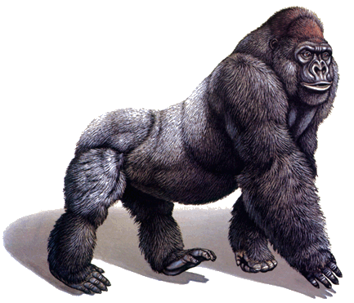
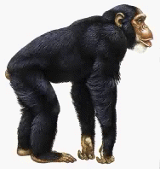
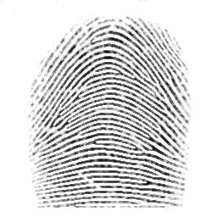
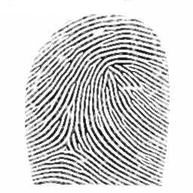
Distance Measures
Definition: Let O₁ and O₂ be two objects from the universe of possible objects. The distance (dissimilarity) between O₁ and O₂ is a real number denoted by D(O₁,O₂)
Peter
Piotr
0.23
3
342.7

Slide 9
Distance Measures
What properties should a distance measure have?
D(A,B) = D(B,A) Symmetry
D(A,A) = 0 Constancy of Self-Similarity
D(A,B) = 0 iif A= B Positivity (Separation)
D(A,B) ≤ D(A,C) + D(B,C) Triangular Inequality

Slide 10
Desirable Properties of a Clustering Algorithm
Scalability (in terms of both time and space)
Ability to deal with different data types
Minimal requirements for domain knowledge to determine input parameters
Interpretability and usability
Optional
Incorporation of user-specified constraints
Notes:
We need to combine all the

Slide 11


Clustering Methods
Partitional algorithms
Hierarchical algorithms
Density-based algorithms
Mixture model
Spectral methods
Hierarchical
Partitional
Notes:
We need to combine all the

Slide 12
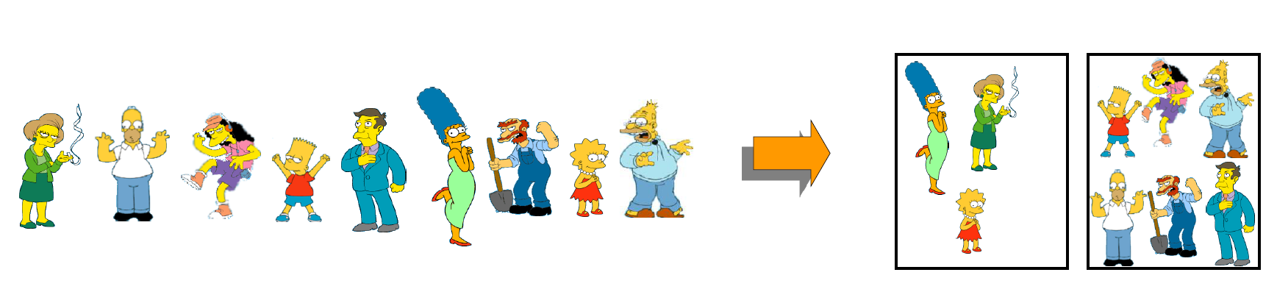
Partitional Clustering
Nonhierarchical, each instance is placed in exactly one of K non-overlapping clusters.
Since the output is only one set of clusters, the user has to specify the desired number of clusters K.
Notes:
We need to combine all the

Slide 13
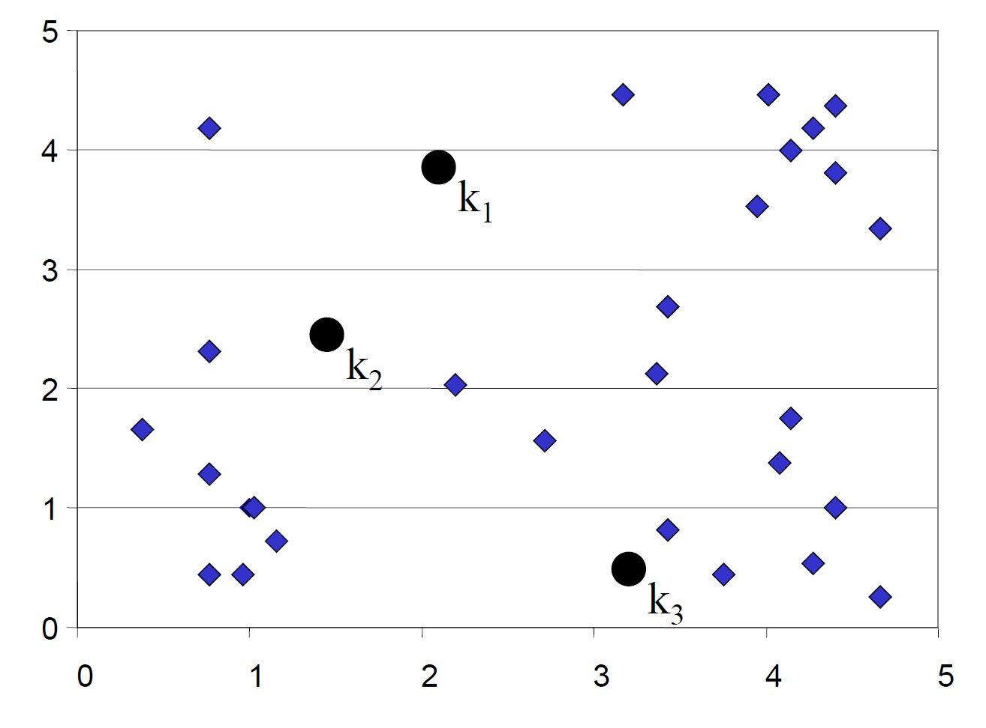
K-means Clustering: Initialization
Algorithm: k-means, Distance Metric: Euclidean Distance
Decide K, and initialize K centers (randomly)
Notes:
We need to combine all the

Slide 14
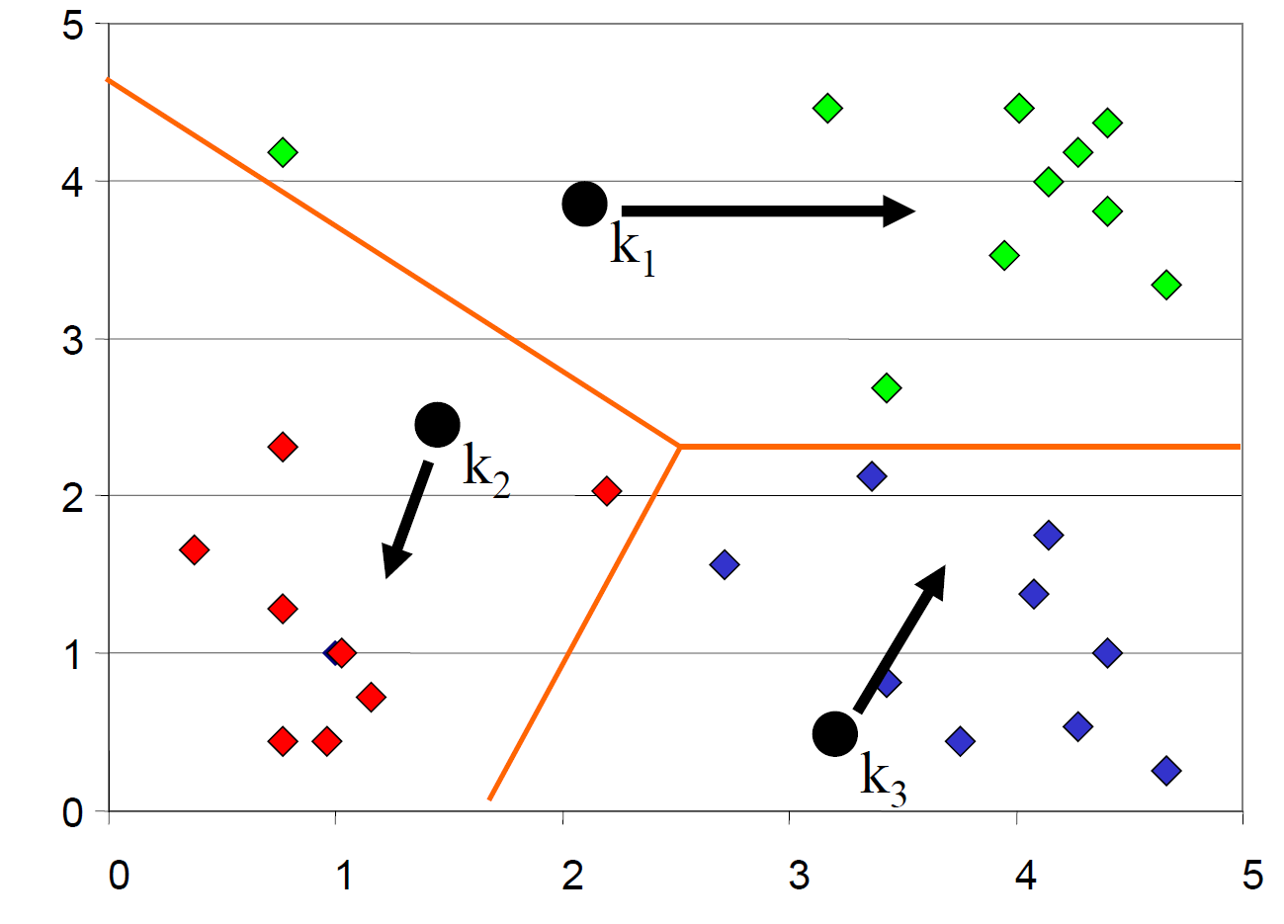
K-means Clustering: Iteration 1
Assign all objects to the nearest center.
Move a center to the mean of its members.
Notes:
We need to combine all the

Slide 15
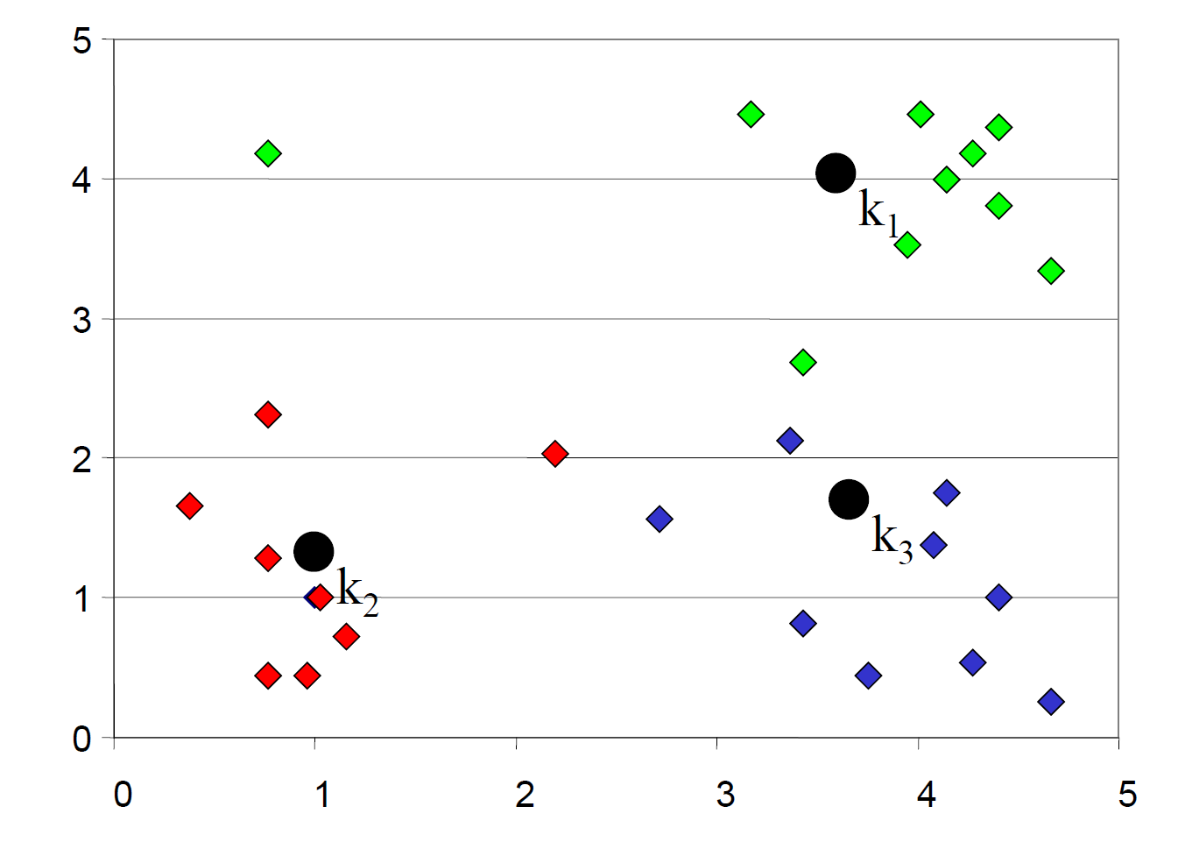
K-means Clustering: Iteration 2
After moving centers, re-assign the objects.
Notes:
We need to combine all the

Slide 16
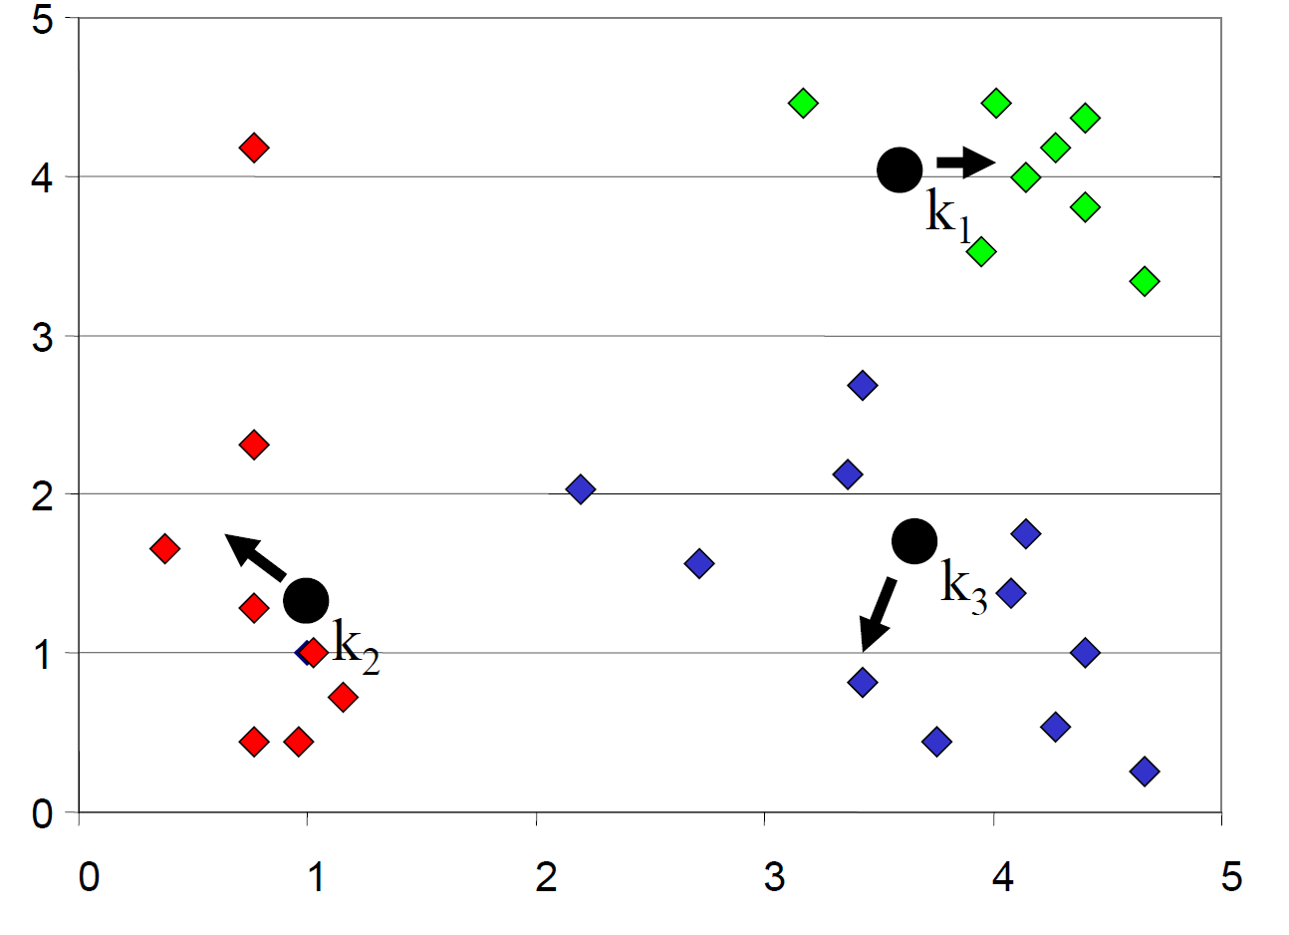
K-means Clustering: Iteration 2
After moving centers, re-assign the objects to nearest centers.
Move a center to the mean of its new members.
Notes:
We need to combine all the

Slide 17
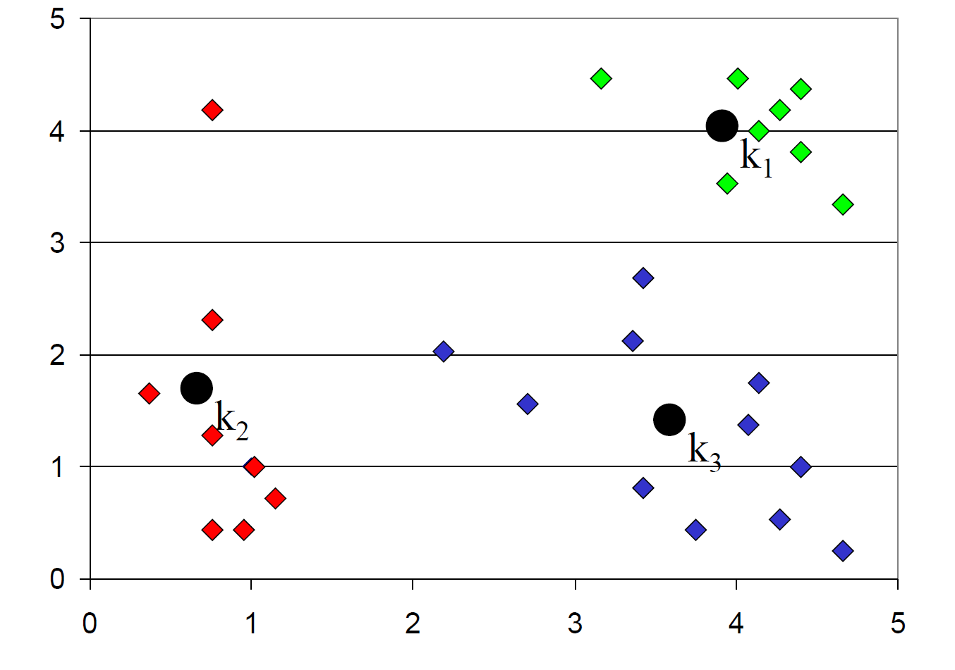
K-means Clustering: Finished
Re-assign and move centers, until
no objects changed membership
Notes:
We need to combine all the

Slide 18
Algorithm K-means
1. Decide on a value of K, the number of clusters.
2. Initialize the K cluster centers (randomly, if necessary)
3. Decide the class memberships of the N objects by assigning them to the nearest cluster center.
4. Re-estimate the K cluster centers, by assuming the memberships found above are correct.
5. Repeat 3 and 4 until none of the N objects changed membership in the last iteration.
Notes:
We need to combine all the

Slide 19
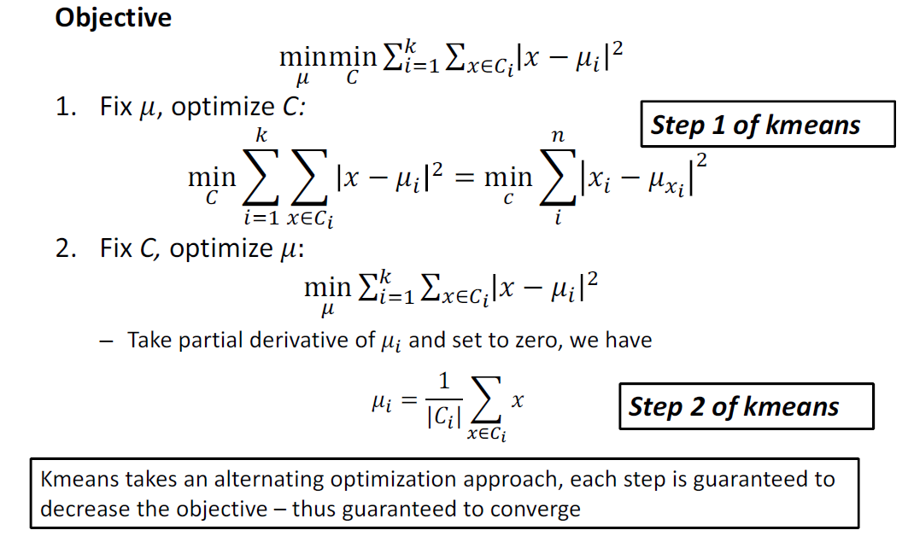
Algorithm K-means
Notes:
We need to combine all the

Slide 20
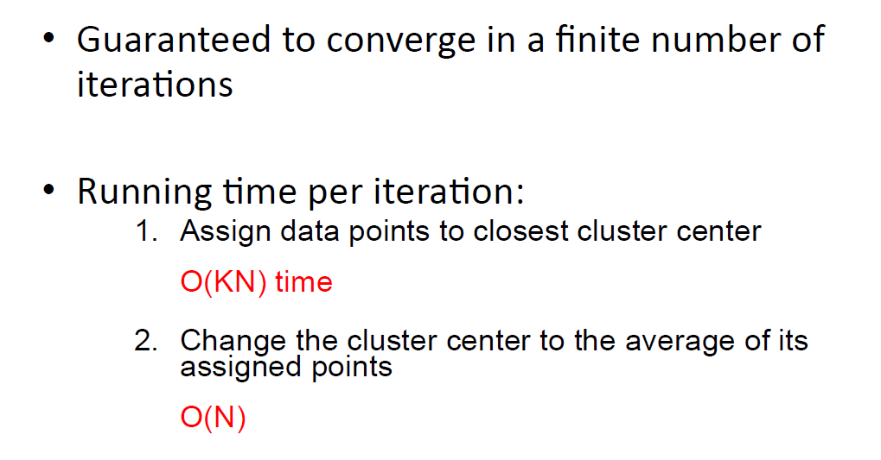
Why K-means Works
Notes:
We need to combine all the

Slide 21
Summary: K-means
Strengths
Relatively efficient: O(tKN), where N is # objects, K is # clusters, and t is # iterations. Normally, K, t << N.
Simple, easy to implement.
Weakness
Applicable only when mean is defined, then what about categorical data?
Often terminates at a local optimum.
Need to specify K, the number of clusters, in advance.
Unable to handle noisy data and outliers.
Not suitable to discover clusters with non-convex shapes.
Notes:
We need to combine all the

Slide 22
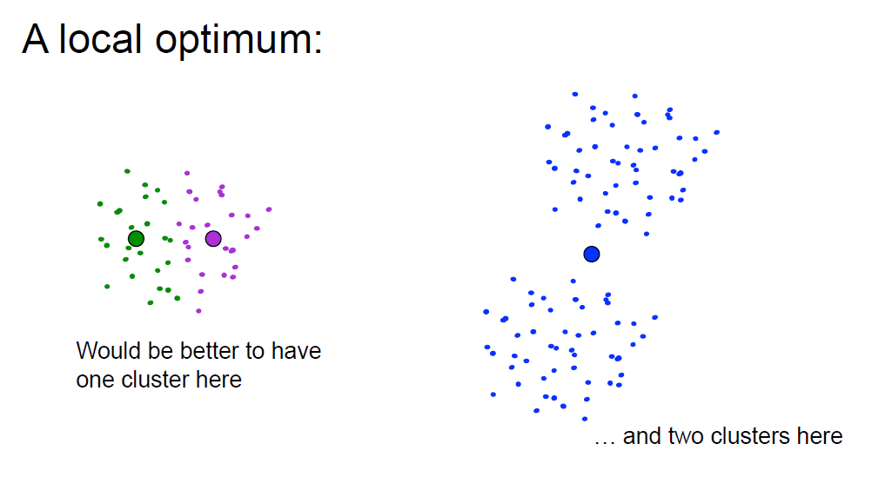
Summary: K-means
Notes:
We need to combine all the

Slide 23
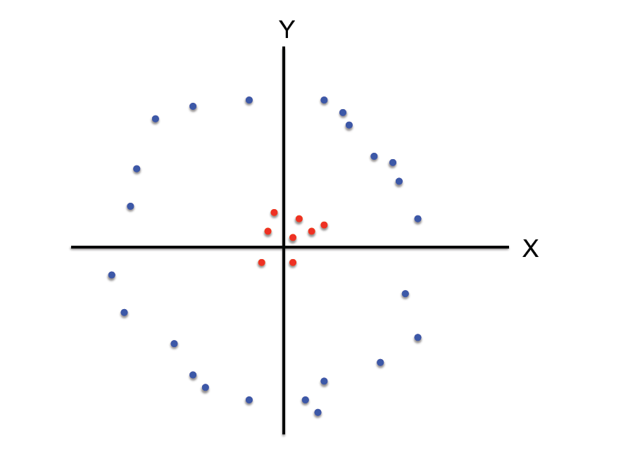
Summary: K-means
K-means not able to properly cluster
Notes:
We need to combine all the

Slide 24
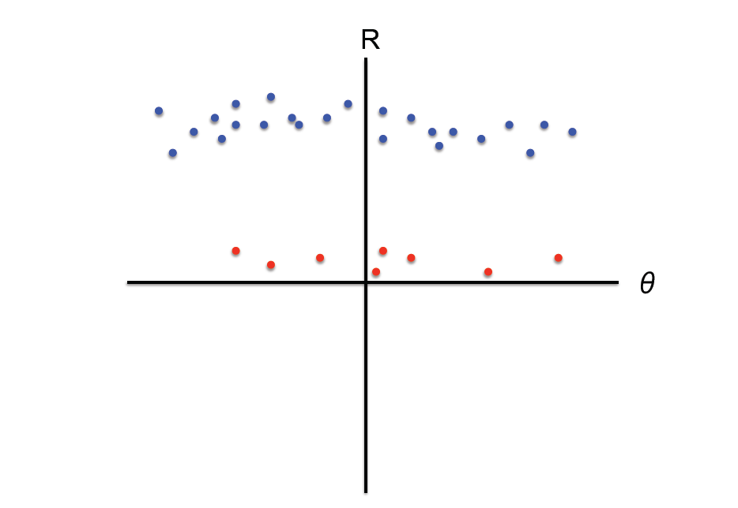
Summary: K-means
Changing the features (distance function) can help
Notes:
We need to combine all the

Slide 25
Dendrogram: A Useful Tool for Summarizing Similarity Measurements
Hierarchical Clustering
The similarity between two objects in a dendrogram is represented as the height of the lowest internal node they share.

Slide 26











Hierarchical Clustering
Hierarchal clustering can sometimes show patterns that are meaningless or spurious
The tight grouping of Australia, Anguilla, St. Helena etc is meaningful; all these countries are former UK colonies
However the tight grouping of Niger and India is completely spurious; there is no connection between the two.
St. Helena &
Dependencies
South Georgia &
South Sandwich
Islands
Serbia &
Montenegro
(Yugoslavia)
AUSTRALIA
ANGUILLA
U.K.
FRANCE
NIGER
INDIA
IRELAND
BRAZIL

Slide 27
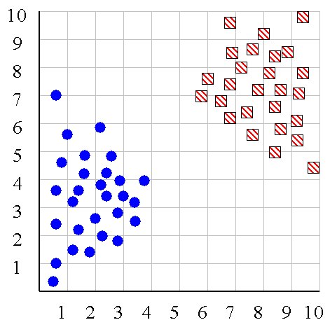
Hierarchical Clustering
We can look at the dendrogram to determine the “correct” number of clusters.
Notes:
In this case, the two highly separated subtrees are highly suggestive of two clusters. (Things are rarely this clear cut, unfortunately)

Slide 28
Hierarchical Clustering
One potential use of a dendrogram: detecting outliers
The single isolated branch is suggestive of a data point that is very different to all others
Outlier

Slide 29
Hierarchical Clustering
The number of dendrograms with n leafs = (2n -3)!/[(2^{(n -2)}) (n -2)!]
Number Number of Possible
of Leafs Dendrograms
2 1
3 3
4 15
5 105
... …
34,459,425
Since we cannot test all possible trees we will have to heuristic search of all possible trees. We could do this..
Bottom-Up (agglomerative): Starting with each item in its own cluster, find the best pair to merge into a new cluster. Repeat until all clusters are fused together.
Top-Down (divisive): Starting with all the data in a single cluster, consider every possible way to divide the cluster into two. Choose the best division and recursively operate on both sides.

Slide 30


Hierarchical Clustering
We begin with a distance matrix which contains the distances between every pair of objects in our database.
0
8
8
7
7
0
2
4
4
D( , ) = 8
D( , ) = 1
0
3
3
0
1
0
Notes:
We need to combine all the

Slide 31
Hierarchical Clustering
Bottom-Up (agglomerative): Starting with each item in its own cluster, find the best pair to merge into a new cluster. Repeat until all clusters are fused together.
Consider all possible merges…
Choose the best
…
Notes:
We need to combine all the

Slide 32
Hierarchical Clustering
Bottom-Up (agglomerative): Starting with each item in its own cluster, find the best pair to merge into a new cluster. Repeat until all clusters are fused together.
Consider all possible merges…
Choose the best
…
Consider all possible merges…
Choose the best
…
Notes:
We need to combine all the

Slide 33
Hierarchical Clustering
Bottom-Up (agglomerative): Starting with each item in its own cluster, find the best pair to merge into a new cluster. Repeat until all clusters are fused together.
Consider all possible merges…
Choose the best
…
Consider all possible merges…
Choose the best
…
Consider all possible merges…
Choose the best
…
Notes:
We need to combine all the

Slide 34
Hierarchical Clustering
Bottom-Up (agglomerative): Starting with each item in its own cluster, find the best pair to merge into a new cluster. Repeat until all clusters are fused together.
Consider all possible merges…
Choose the best
…
Consider all possible merges…
Choose the best
…
Consider all possible merges…
Choose the best
…
Notes:
We need to combine all the

Slide 35
Hierarchical Clustering
We know how to measure the distance between two objects, but defining the distance between an object and a cluster, or defining the distance between two clusters is non obvious.
Single linkage (nearest neighbor): In this method the distance between two clusters is determined by the distance of the two closest objects (nearest neighbors) in the different clusters.
Complete linkage (furthest neighbor): In this method, the distances between clusters are determined by the greatest distance between any two objects in the different clusters (i.e., by the "furthest neighbors").
Group average linkage: In this method, the distance between two clusters is calculated as the average distance between all pairs of objects in the two different clusters.
Notes:
We need to combine all the

Slide 36
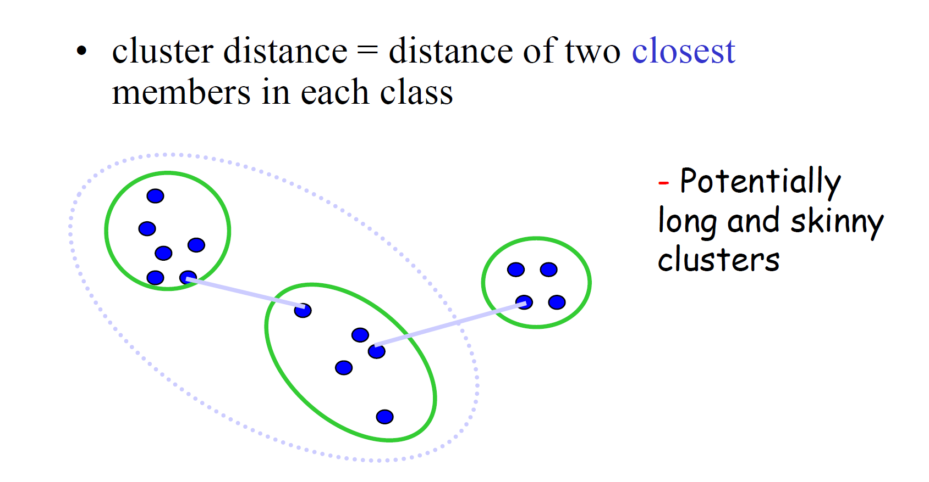
Computing distance between clusters: Single Link
Notes:
We need to combine all the

Slide 37
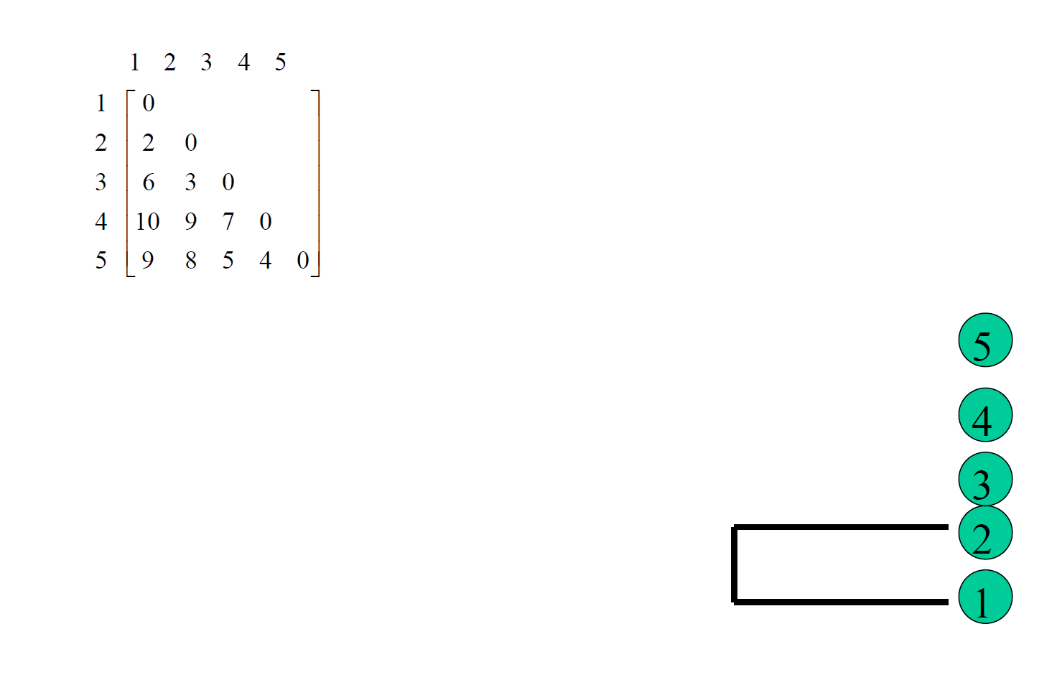
Example: Single Link
Notes:
We need to combine all the

Slide 38
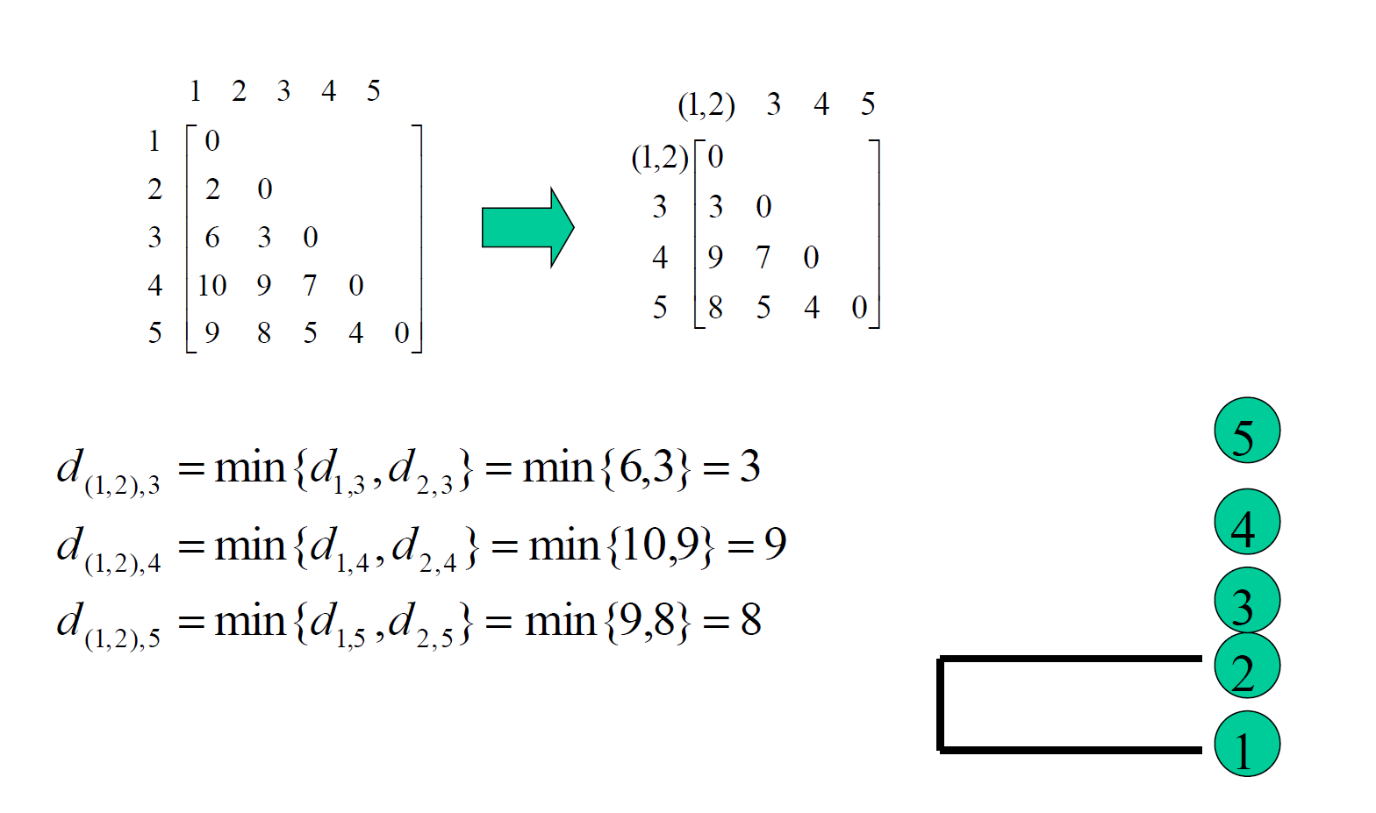
Example: Single Link
Notes:
We need to combine all the

Slide 39
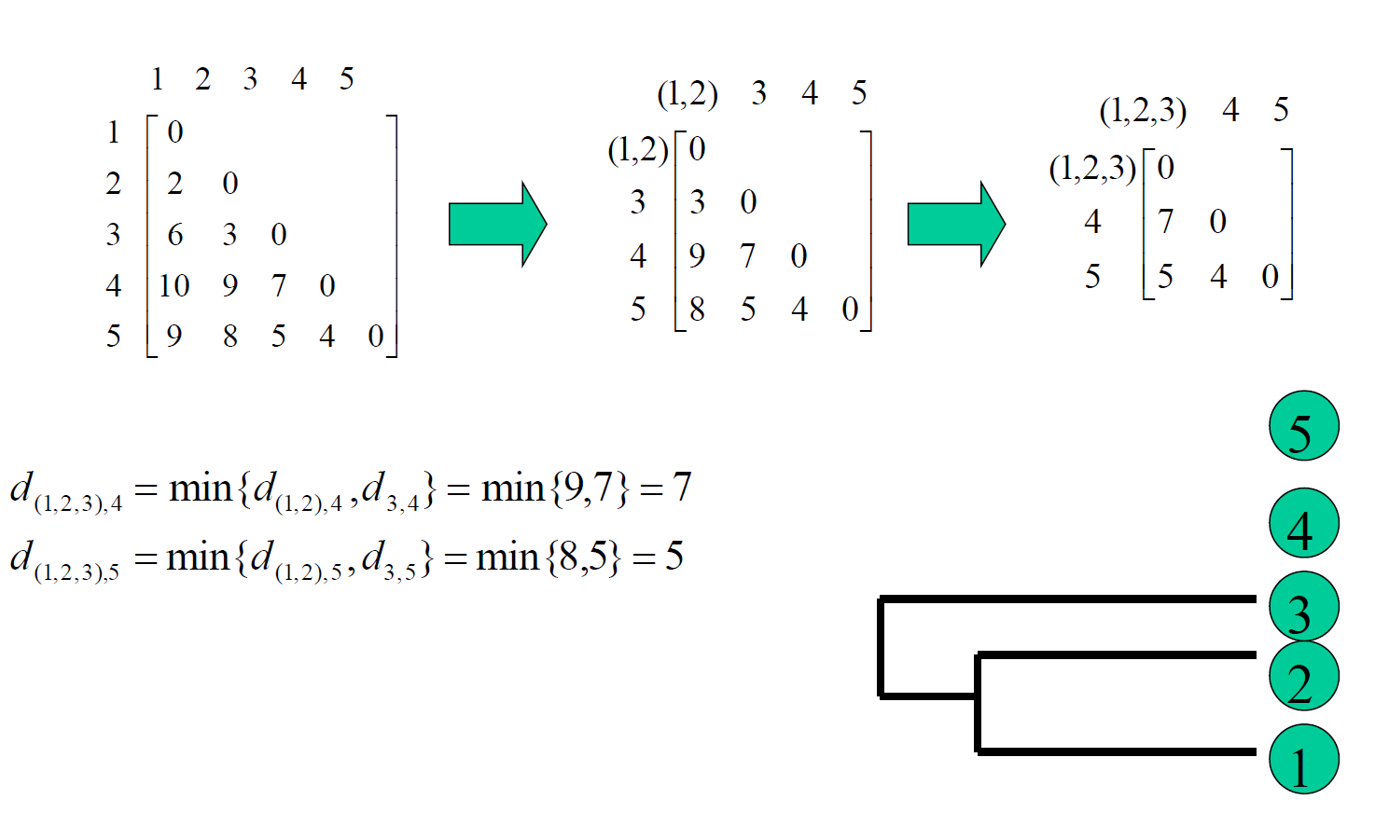
Example: Single Link
Notes:
We need to combine all the

Slide 40
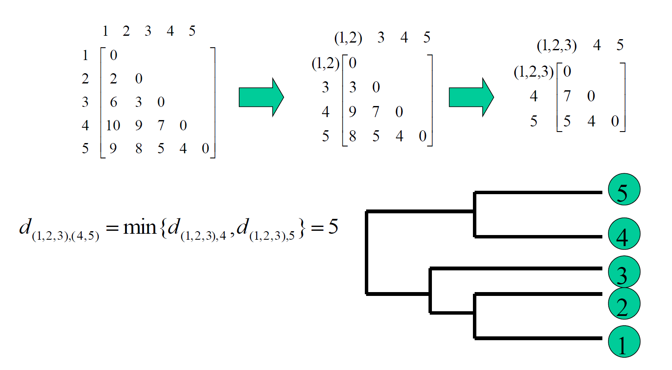
Example: Single Link
Notes:
We need to combine all the

Slide 41
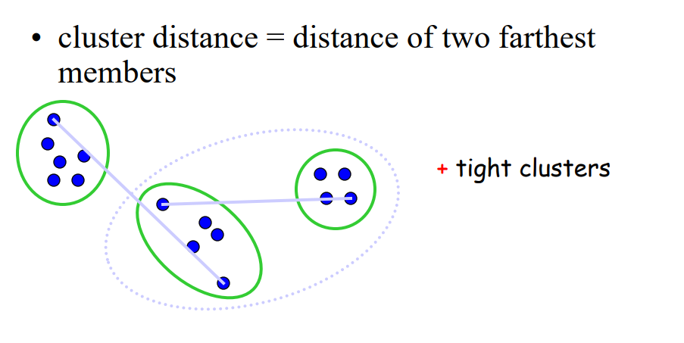
Computing distance between clusters: Complete Link
Notes:
We need to combine all the

Slide 42
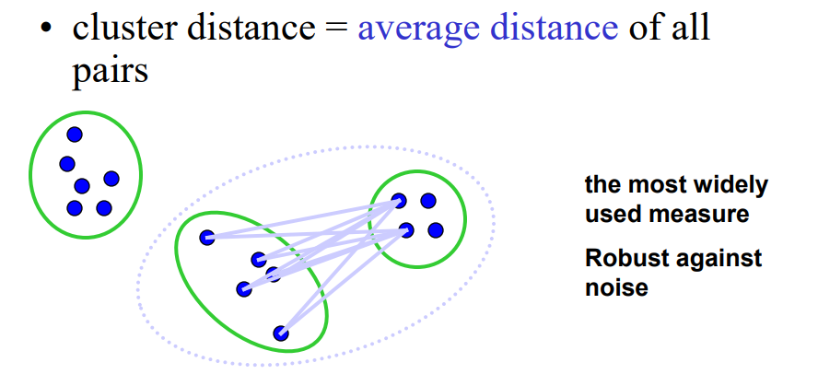
Computing distance between clusters: Average Link
Notes:
We need to combine all the

Slide 43
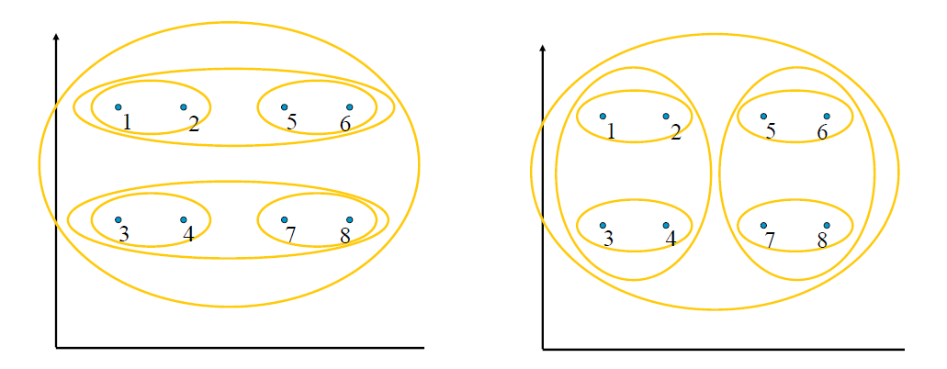
Hierarchical Clustering
Single Link
Complete Link
Notes:
We need to combine all the

Slide 44
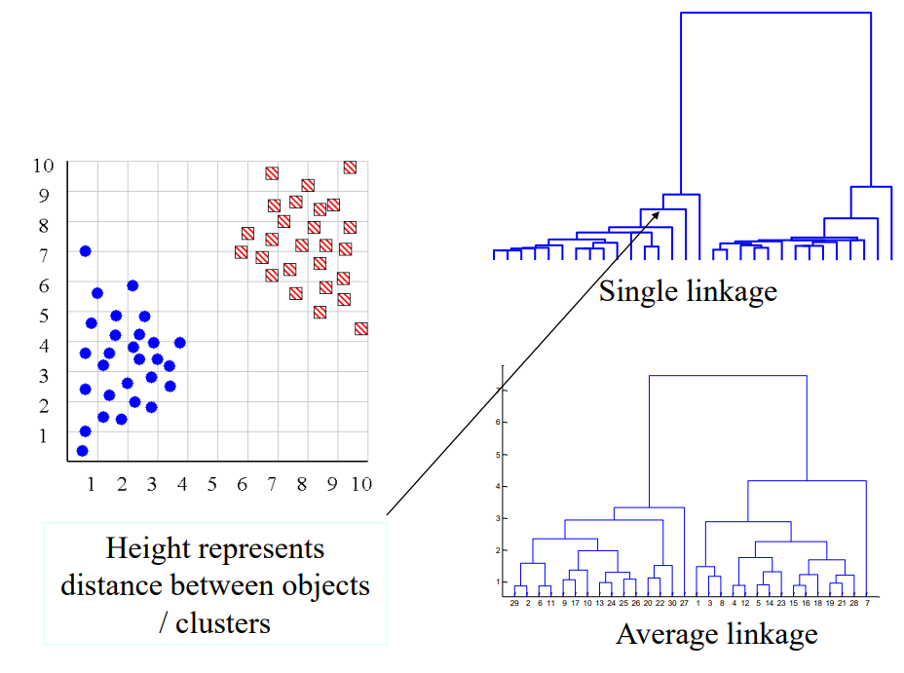
Hierarchical Clustering
Height represents distance between objects/clusters
Notes:
We need to combine all the

Slide 45
Summary: Hierarchical Clustering
No need to specify the number of clusters in advance
Hierarchal nature maps nicely onto human intuition for some domains
They do not scale well: time complexity of at least O(N²), where N is the number of total objects
Like any heuristic search algorithms, local optima are a problem
Interpretation of results is (very) subjective

Slide 46
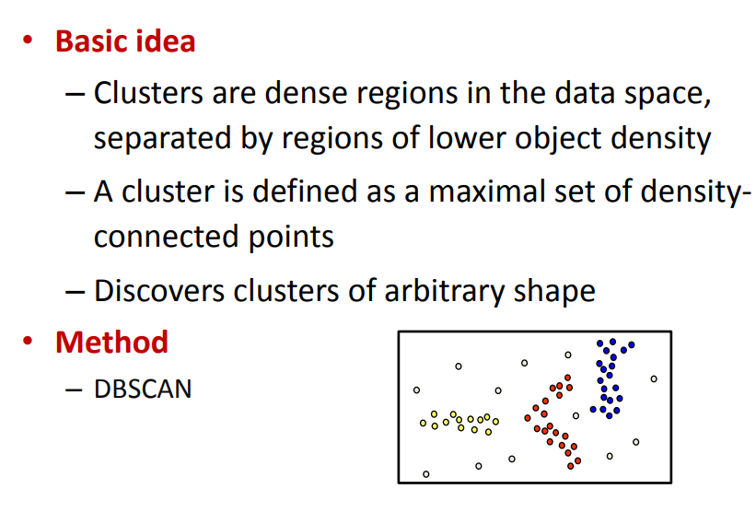
Density-based Clustering
Notes:
We need to combine all the

Slide 47
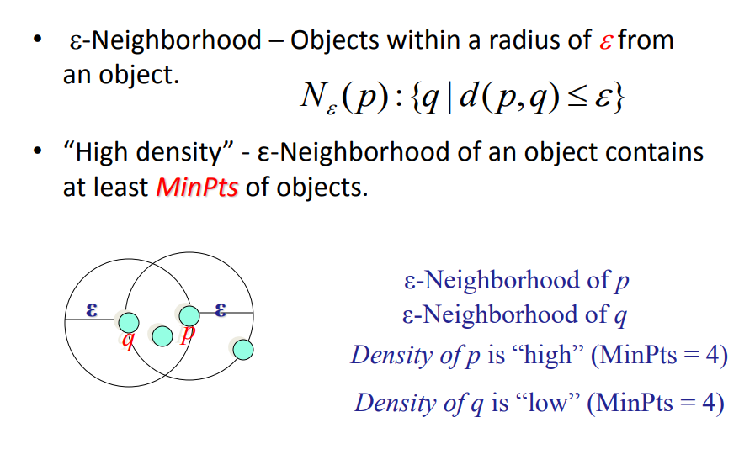
Density Definition
Notes:
We need to combine all the

Slide 48
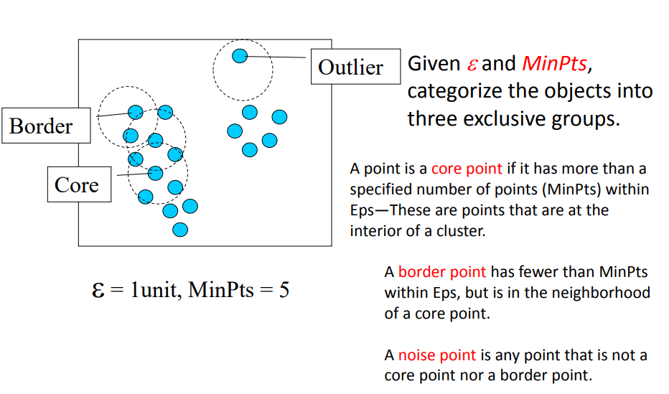
Core, Border & Outlier
Notes:
We need to combine all the

Slide 49
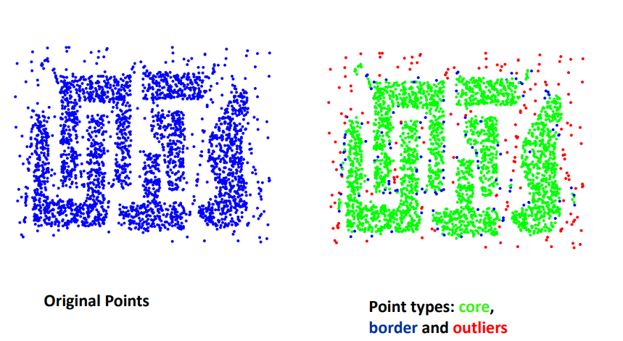
Example
Notes:
We need to combine all the

Slide 50
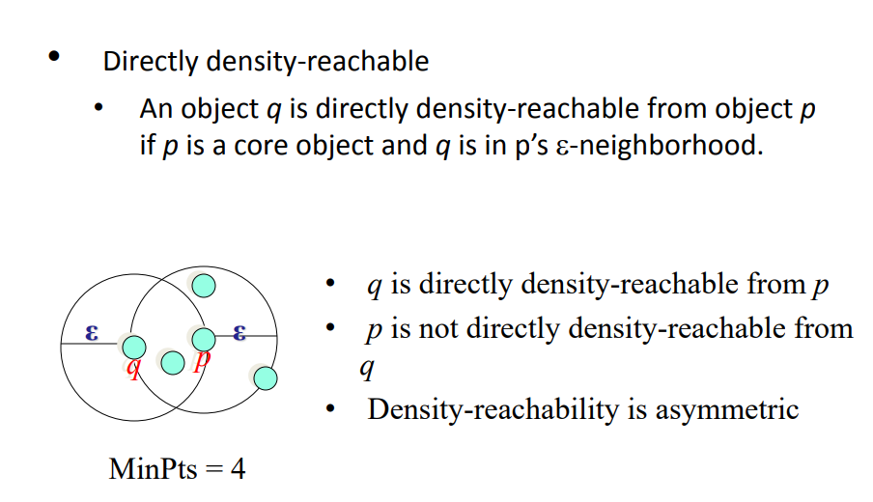
Density-reachability
Notes:
We need to combine all the

Slide 51
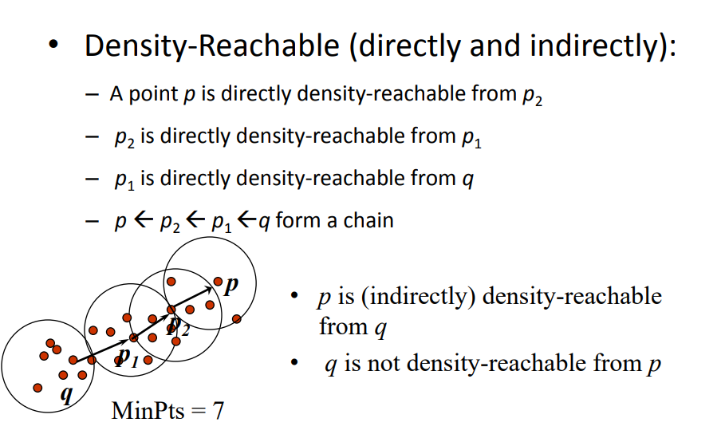
Density-reachability
Notes:
We need to combine all the

Slide 52
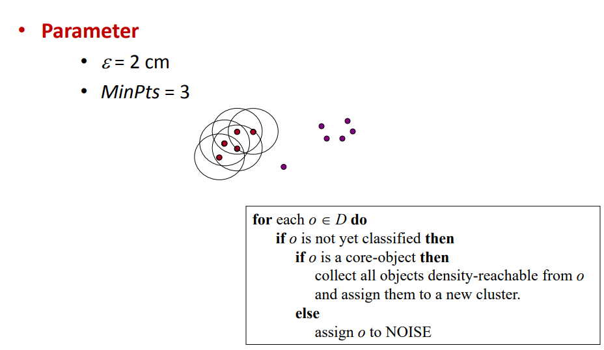
DBSCAN Algorithm: Example
Notes:
We need to combine all the

Slide 53
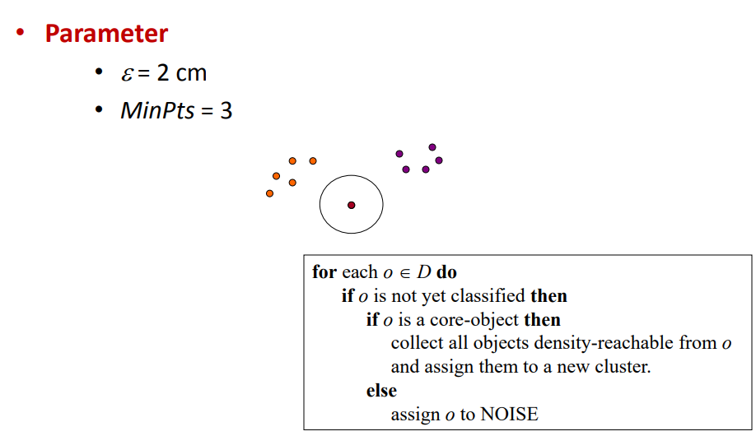
DBSCAN Algorithm: Example
Notes:
We need to combine all the

Slide 54
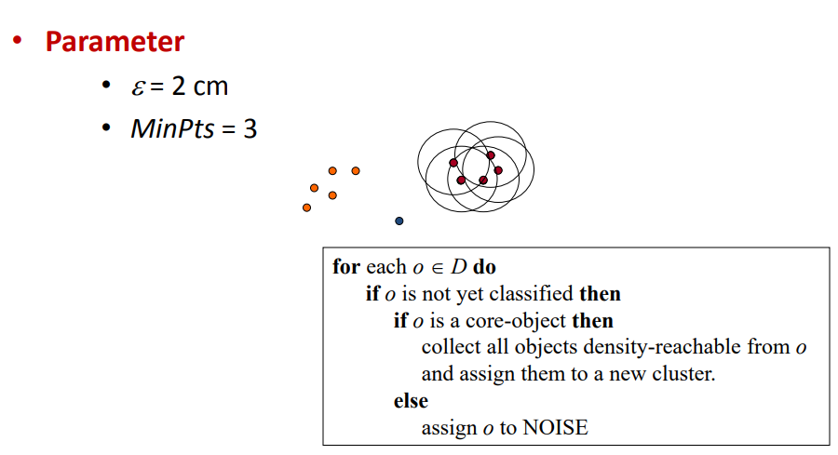
DBSCAN Algorithm: Example
Notes:
We need to combine all the

Slide 55
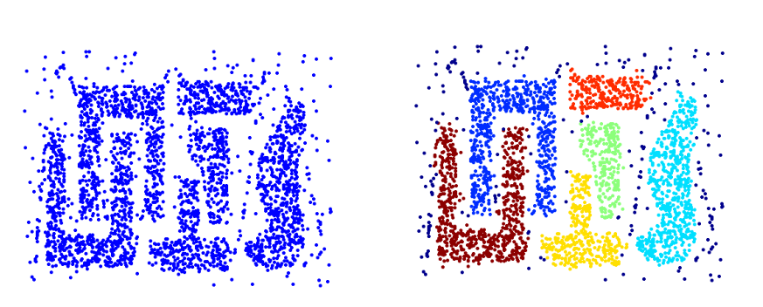
When DBSCAN Works Well
Original Points
Clusters
Resistant to Noise
Can handle clusters of different shapes and sizes
Notes:
We need to combine all the

Slide 56
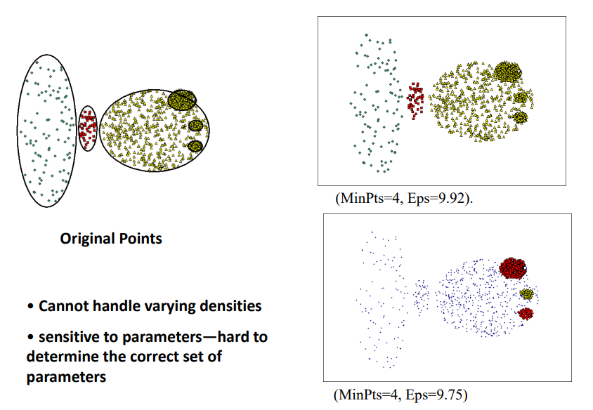
When DBSCAN Does Not Works Well
Original Points
Cannot handle varying densities
Sensitive to parameters -hard to determine the correct set of parameters
Clusters
Notes:
We need to combine all the

